Slide 1

Project Management and Entrepreneurship KHU-802
DEPARTMENT OF IT

Slide 2
Project Cost Estimation
What is a cost estimate?
Project cost estimation is the process of predicting the quantity, cost, and price of the resources required by the scope of a project.
Since cost estimation is about the prediction of costs rather than counting the actual cost, a certain degree of uncertainty is involved. This uncertainty arises from the fact that the project scope definition is never entirely complete until the project has been finished, at which point all expenses have been made and an accountant can determine the exact amount of money spent on resources.
Cost estimation, therefore, is like ‘looking into a crystal ball’.

Slide 3
Why project cost estimation?
Different reasons:
- Investment decisions,
- Comparing alternative plans,
- Budgeting,
- Cost control, and validation.
Cost estimates are prepared to different ends throughout the project lifecycle. Upfront, the goal is to provide input for investment decisions. The cost estimate is used to determine the size of the required investment to create or modify assets. It is also during the early phases that alternative plans are considered that need to be priced. The cost estimate is a deliverable that serves the decision-making process at each gate of the project lifecycle

Slide 4
Why project cost estimation is important??
There are many reasons why cost estimation is an indispensable part of project management.
A cost estimate reflects if the project is financially viable. First things first, an accurate cost estimate is essential for deciding if the project is feasible or not for the company at the moment. In this light, a cost estimate answers if the project can be completed with available resources in the given time period and still bring value to the organization.
Cost estimation helps to stay on schedule and on track. At the end of the day, sound project estimates are important to ensure that actual effort, once the project is in progress, matches the estimated targets that were set at the beginning of the project to the greatest possible extent. Thus estimates are one of the foundational pillars for safeguarding client expectations and your company’s bottom line.

Slide 5
Common project cost estimation techniques
Depending on your project type and size, stakeholder expectations, potential billing method, and other project-related factors, various techniques and tools can be applied to make an educated guess about the project’s price. We’ve gathered them in one table together with recommendations.
Estimation Bottom-up estimation | Definition Assigning costs to the individual elements of the project plan, such as tasks, milestones, or phases, and putting the bucks together | Requirements Best for estimating projects with defined expectations and specific requirements in line with stakeholders who won’t expect major changes in the scope

Slide 6
Common project cost estimation techniques
Estimation Top-down estimation Analogous estimation Parametric estimation Three-point estimation | Definition Figuring out the project’s total price and determining the scope of work that can be done. Relying on data from previous similar projects to forecast the cost. Taking specific cost variables and data points from other projects to figure out the ultimate project cost. Doing the average from the best, worst, and most likely case estimations | Requirements Commonly used to estimate elements on fixed price projects when the price is initially specified by the client Recommended when there’s limited information about the project. Usually called in for use when the previous project data you have is scalable Well-advised when the risk of going over budget is high

Slide 7
Prime reasons for inaccurate project cost estimates
More often than not, project cost estimates turn out to be off-the-mark. The main reason being the timing when they’re made - during the proposal phase - that is when you know the least about the project, plus many other factors that compromise the quality of cost estimates. The common pitfalls to watch out for that can destroy the accuracy and reliability of your estimates are:
Long Sighted predictions. Seasoned project managers know that every estimate is a premature estimate if it’s made a long time in advance, let’s say to predict the budget three years ahead. It immediately turns into a guess estimate that will hardly be relevant then.
Shortage of expertise on similar projects. There is no denial of the fact that better cost estimates come with experience on comparable initiatives. Analogous projects inform your next estimation decisions by giving you a clearer understanding of how the new project can be better scoped out and which milestones take longer than usual.
Lack of requirements. Having an idea what the project is all about is not enough. To provide an accurate estimate, every element in the project should be specified per client’s request. Staying on the same page with the client will help you break the project down into manageable chunks of work and ensure that you don't miss out on anyone’s expectations.

Slide 8
Prime reasons for inaccurate project cost estimates
Splitting one task across multiple resources. When more than one person works on a task, clear processes should be set in place, which in turn requires additional planning and management time, often not taken into account. Not only does it make the task last longer, but it also increases chances of overshot deadlines and estimates. In the end, one task divided between multiple team members turns out to be more costly than you initially thought.
Expecting that resources will work at full battery. Total efficiency at workplace is a utopia we all want to believe in. There will always be “dead time” or unexpected non-billable work. A more reasonable number to target would be 70-80%. Don’t forget to include that when scoping your next project.

Slide 9
The pros of using a spreadsheet for cost estimation
Almost an industry standard
Low barrier for entry (Most people have access to it and know how to use it)
Very adaptable and customizable
Easy to analyze, present, and pivot data (for a single project at least)
Easy to copy and distribute

Slide 10
The cons of using a spreadsheet for cost estimation
Very adaptable and customizable
Error-prone due to its manual nature
Only accessible locally and not by multiple people at the same time
Easy to copy and distribute (How do you easily merge input from 10 people?)
Almost impossible to consolidate input of data due to its delicate nature
No easy way to learn from previous projects and take advantage of historic data
Rubbish at comparing projects and their data without substantial manual effort
No version control (Which always results in substantial rework)
Very hard to track Key Performance Indicators (KPIs) in a timely manner to react to them

Slide 11
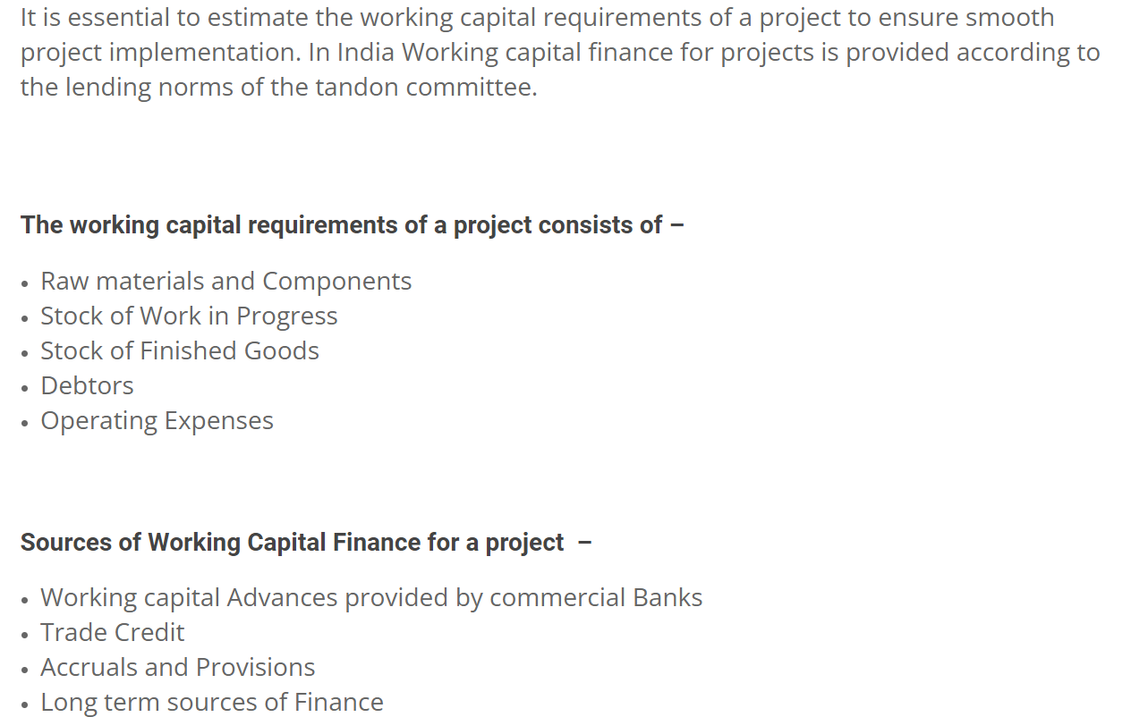
Working Capital Requirements of a Project

Slide 12
Estimation of Working Capital Requirements
In estimating working capital needs, different people adopt different approaches. Some experts suggest that the working capital should be greater than the minimum requirements of the firm. The management should feel safety. It would be able to meet its obligations even in adverse circumstances. However, the excessive capital may lead to waste and inefficiency. On the other hand, some experts suggest that the working capital should be lower than the requirement so that no idle funds shall be invested in the current assets and it ultimately leads to increase in profitability of the company.
There are various approaches which have been applied in practice for the estimation of working capital requirements.
1. Conservative Approach
The conservative approach states that the proportion of current assets to current liabilities should be kept at 2:1. Is this proportion is to be kept the firm would be able to meet its obligations on time and hence its financial solvency would not be in trouble.
However, the limitation of this approach is that it suggests only quantitative measure. It does not suggest as to what type of assets are to be included in current assets. If the current assets contain stock, which is outdated or receivable which are not collectable, than the amount of current assets has no meaning.

Slide 13
Estimation of Working Capital Requirements
2. Components Approach
Here we take up one of the planning models of working capital to estimate working capital. The method adopted here attempts at estimation of working capital and its components by taking into account, the period for which the various items remain as stock or as outstanding, the cost structure of production and annual production.
3. Operating Cycle Approach
It was earlier referred to that working capital is also known as revolving capital. That is, a circular path of conversion/re-conversion takes place.

Slide 14
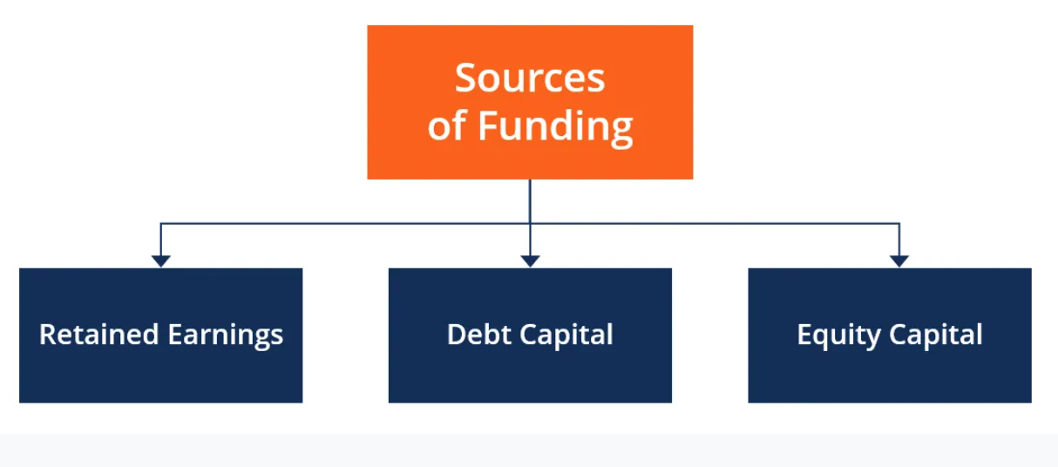
What are Sources of Funding?
Companies always seek sources of funding to grow the business. Funding, also called financing, represents an act of contributing resources to finance a program, project, or a need. Funding can be initiated for either short-term or long-term purposes. The different sources of funding include:
Retained earnings
Debt capital
Equity capital

Slide 15
What are Sources of Funding?
Retained Earnings
Businesses aim to maximize profits by selling a product or rendering service for a price higher than what it costs them to produce the goods. It is the most primitive source of funding for any company.
After generating profits, a company decides what to do with the earned capital and how to allocate it efficiently. The retained earnings can be distributed to shareholders as dividends, or the company can reduce the number of shares outstanding by initiating a stock repurchase campaign.
Alternatively, the company can invest the money into a new project, say, building a new factory, or partnering with other companies to create a joint venture

Slide 16
What are Sources of Funding?
Debt Capital
Companies obtain debt financing privately through bank loans. They can also source new funds by issuing debt to the public.
In debt financing, the issuer (borrower) issues debt securities, such as corporate bonds or promissory notes. Debt issues also include debentures, leases.
Companies that initiate debt issues are borrowers because they exchange securities for cash needed to perform certain activities. The companies will be then repaying the debt (principal and interest) according to the specified debt repayment schedule and contracts underlying the issued debt securities.
The drawback of borrowing money through debt is that borrowers need to make interest payments, as well as principal repayments, on time. Failure to do so may lead the borrower to default or bankruptcy.

Slide 17
What are Sources of Funding?
Equity Capital
Companies can raise funds from the public in exchange for a proportionate ownership stake in the company in the form of shares issued to investors who become shareholders after purchasing the shares.
Alternatively, private equity financing can be an option, provided there are entities or individuals in the company’s or directors’ network ready to invest in a project or wherever the money is needed for.
Compared to debt capital funding, equity funding does not require making interest payments to a borrower.
However, one disadvantage of equity capital funding is sharing profits among all shareholders in the long term. More importantly, shareholders dilute a company’s ownership control as long as it sells more shares.

Slide 18
What are Sources of Funding?
Other Funding Sources
Funding sources also include private equity, venture capital, donations, grants, and subsidies that do not have a direct requirement for return on investment (ROI), except for private equity and venture capital. They are also called “crowd funding” or “soft funding.”
Crowd funding represents a process of raising funds to fulfill a certain project or undertake a venture by obtaining small amounts of money from a large number of individuals. The crowd funding process usually takes place online.

Slide 19
What Is Capital Budgeting?
Capital budgeting involves choosing projects that add value to a company. The capital budgeting process can involve almost anything including acquiring land or purchasing fixed assets like a new truck or machinery.
Corporations are typically required, or at least recommended, to undertake those projects that will increase profitability and thus enhance shareholders' wealth.
However, the rate of return deemed acceptable or unacceptable is influenced by other factors specific to the company as well as the project.
For example, a social or charitable project is often not approved based on the rate of return, but more on the desire of a business to foster goodwill and contribute back to its community.

Slide 20
What Is Capital Budgeting?
KEY TAKEAWAYS
Capital budgeting is the process by which investors determine the value of a potential investment project.
The three most common approaches to project selection are payback period (PB), internal rate of return (IRR), and net present value (NPV).
The payback period determines how long it would take a company to see enough in cash flows to recover the original investment.
The internal rate of return is the expected return on a project—if the rate is higher than the cost of capital, it's a good project.
The net present value shows how profitable a project will be versus alternatives and is perhaps the most effective of the three methods.
.

Slide 21
Major Methods
Many formal methods are used in capital budgeting, including the techniques as followed:
Net present value
Internal rate of return
Payback period
Profitability index
Equivalent annuity
Real options analysis

Slide 22
Major Methods
Net Present Value
Net present value (NPV) is used to estimate each potential project’s value by using a discounted cash flow (DCF) valuation. This valuation requires estimating the size and timing of all the incremental cash flows from the project. The NPV is greatly affected by the discount rate, so selecting the proper rate sometimes called the hurdle rate–is critical to making the right decision.

Slide 23
UNIT- IV– Risk Analysis
Risk & Uncertainty
PROJECT MANAGEMENT
Notes:
A project is a unique endeavor to produce a set of deliverables within clearly specified time, cost and quality constraints. Projects are different from standard business operational activities as they:
• Are unique in nature. They do not involve repetitive processes. Every project undertaken is different from the last, whereas operational activities often involve undertaking repetitive (identical) processes.
• Have a defined timescale. Projects have a clearly specified start and end date within which the deliverables must be produced to meet a specified customer requirement.
• Have an approved budget. Projects are allocated a level of financial expenditure within which the deliverables are produced, to meet a specified customer requirement.
• Have limited resources. At the start of a project an agreed amount of labor, equipment and materials is allocated to the project.
• Involve an element of risk. Projects entail a level of uncertainty and therefore carry business risk.
• Achieve beneficial change. The purpose of a project is typically to improve an organization through the implementation of business change.

Slide 24

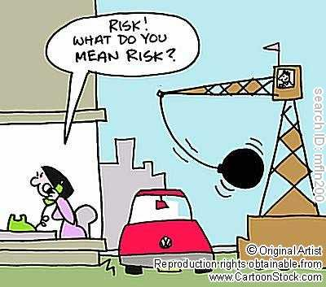
UNIT- IV– Risk Analysis
Risk
Risk is the possibility of outcome being different form the expected outcome.
If the probabilities of possible outcome of a given problem are known, we can conclude that the problem contains Risk, i.e. the problem is risky.
PROJECT MANAGEMENT
Notes:
A project is a unique endeavor to produce a set of deliverables within clearly specified time, cost and quality constraints. Projects are different from standard business operational activities as they:
• Are unique in nature. They do not involve repetitive processes. Every project undertaken is different from the last, whereas operational activities often involve undertaking repetitive (identical) processes.
• Have a defined timescale. Projects have a clearly specified start and end date within which the deliverables must be produced to meet a specified customer requirement.
• Have an approved budget. Projects are allocated a level of financial expenditure within which the deliverables are produced, to meet a specified customer requirement.
• Have limited resources. At the start of a project an agreed amount of labor, equipment and materials is allocated to the project.
• Involve an element of risk. Projects entail a level of uncertainty and therefore carry business risk.
• Achieve beneficial change. The purpose of a project is typically to improve an organization through the implementation of business change.

Slide 25
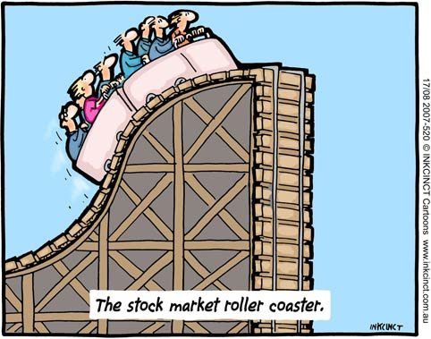
UNIT- IV– Risk Analysis
Uncertainty
If the probabilities of possible outcome of a given problem are not known, we can conclude that the problem has an element of uncertainty, i.e. the outcome can not be predicted.
PROJECT MANAGEMENT
Notes:
A project is a unique endeavor to produce a set of deliverables within clearly specified time, cost and quality constraints. Projects are different from standard business operational activities as they:
• Are unique in nature. They do not involve repetitive processes. Every project undertaken is different from the last, whereas operational activities often involve undertaking repetitive (identical) processes.
• Have a defined timescale. Projects have a clearly specified start and end date within which the deliverables must be produced to meet a specified customer requirement.
• Have an approved budget. Projects are allocated a level of financial expenditure within which the deliverables are produced, to meet a specified customer requirement.
• Have limited resources. At the start of a project an agreed amount of labor, equipment and materials is allocated to the project.
• Involve an element of risk. Projects entail a level of uncertainty and therefore carry business risk.
• Achieve beneficial change. The purpose of a project is typically to improve an organization through the implementation of business change.

Slide 26
UNIT- IV– Risk Analysis
Types of Risk
Completion Risk (if the project seems not to be completed in time)
Technical Risk (if it seems failure to meet a particular performance)
Social Risk (seems to have social cost / against customers or society)
Economic Risk (increase in inflation, policies, income level etc.)
Political Risk (political instability, change in policy, trade restriction)
Production Risk (shortage in inputs, increase in costs)
Marketing Risk (failure of product in satisfying the demand)
Financial Risk (bad debts, change in interest rate, wrong investment)
PROJECT MANAGEMENT
Notes:
A project is a unique endeavor to produce a set of deliverables within clearly specified time, cost and quality constraints. Projects are different from standard business operational activities as they:
• Are unique in nature. They do not involve repetitive processes. Every project undertaken is different from the last, whereas operational activities often involve undertaking repetitive (identical) processes.
• Have a defined timescale. Projects have a clearly specified start and end date within which the deliverables must be produced to meet a specified customer requirement.
• Have an approved budget. Projects are allocated a level of financial expenditure within which the deliverables are produced, to meet a specified customer requirement.
• Have limited resources. At the start of a project an agreed amount of labor, equipment and materials is allocated to the project.
• Involve an element of risk. Projects entail a level of uncertainty and therefore carry business risk.
• Achieve beneficial change. The purpose of a project is typically to improve an organization through the implementation of business change.

Slide 27
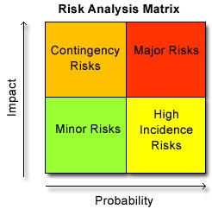
UNIT- IV– Risk Analysis
Risk Analysis
A process of identifying and quantifying the risk involved in a project and developing measures to avoid and manage such risk.
Risk analysis can be classified in two heads:
Risk Analysis | Risk Assessment
 | Risk Management
PROJECT MANAGEMENT
Notes:
A project is a unique endeavor to produce a set of deliverables within clearly specified time, cost and quality constraints. Projects are different from standard business operational activities as they:
• Are unique in nature. They do not involve repetitive processes. Every project undertaken is different from the last, whereas operational activities often involve undertaking repetitive (identical) processes.
• Have a defined timescale. Projects have a clearly specified start and end date within which the deliverables must be produced to meet a specified customer requirement.
• Have an approved budget. Projects are allocated a level of financial expenditure within which the deliverables are produced, to meet a specified customer requirement.
• Have limited resources. At the start of a project an agreed amount of labor, equipment and materials is allocated to the project.
• Involve an element of risk. Projects entail a level of uncertainty and therefore carry business risk.
• Achieve beneficial change. The purpose of a project is typically to improve an organization through the implementation of business change.

Slide 28
UNIT- IV– Risk Analysis
Risk Assessment
A process of identifying and quantifying the risk.
To find out the reasons / sources of risk
To know the probability of occurring of risk.
PROJECT MANAGEMENT
Notes:
A project is a unique endeavor to produce a set of deliverables within clearly specified time, cost and quality constraints. Projects are different from standard business operational activities as they:
• Are unique in nature. They do not involve repetitive processes. Every project undertaken is different from the last, whereas operational activities often involve undertaking repetitive (identical) processes.
• Have a defined timescale. Projects have a clearly specified start and end date within which the deliverables must be produced to meet a specified customer requirement.
• Have an approved budget. Projects are allocated a level of financial expenditure within which the deliverables are produced, to meet a specified customer requirement.
• Have limited resources. At the start of a project an agreed amount of labor, equipment and materials is allocated to the project.
• Involve an element of risk. Projects entail a level of uncertainty and therefore carry business risk.
• Achieve beneficial change. The purpose of a project is typically to improve an organization through the implementation of business change.

Slide 29
UNIT- IV– Risk Analysis
Risk Management
The process of avoiding or minimizing the impact of assessed risk. Risk management at the time of project evaluation may be done as:
At the time of Project Evaluation
At the time of Project Implementation
PROJECT MANAGEMENT
Notes:
A project is a unique endeavor to produce a set of deliverables within clearly specified time, cost and quality constraints. Projects are different from standard business operational activities as they:
• Are unique in nature. They do not involve repetitive processes. Every project undertaken is different from the last, whereas operational activities often involve undertaking repetitive (identical) processes.
• Have a defined timescale. Projects have a clearly specified start and end date within which the deliverables must be produced to meet a specified customer requirement.
• Have an approved budget. Projects are allocated a level of financial expenditure within which the deliverables are produced, to meet a specified customer requirement.
• Have limited resources. At the start of a project an agreed amount of labor, equipment and materials is allocated to the project.
• Involve an element of risk. Projects entail a level of uncertainty and therefore carry business risk.
• Achieve beneficial change. The purpose of a project is typically to improve an organization through the implementation of business change.

Slide 30
UNIT- IV– Risk Analysis
Risk Management
At the time of Project Evaluation
Judgmental Evaluation
(without using any formal method, accepting/rejecting project)
Pay Back Period Requirement
(Risk is a function of time, use of PBP along with NPV or IRR risk)
Risk Adjusted Discount Rate
(r = i + d; r = risk adjusted discount rate, I = normal discount rate, d = risk factor )
Collecting more and more information
(by updating self)
PROJECT MANAGEMENT
Notes:
A project is a unique endeavor to produce a set of deliverables within clearly specified time, cost and quality constraints. Projects are different from standard business operational activities as they:
• Are unique in nature. They do not involve repetitive processes. Every project undertaken is different from the last, whereas operational activities often involve undertaking repetitive (identical) processes.
• Have a defined timescale. Projects have a clearly specified start and end date within which the deliverables must be produced to meet a specified customer requirement.
• Have an approved budget. Projects are allocated a level of financial expenditure within which the deliverables are produced, to meet a specified customer requirement.
• Have limited resources. At the start of a project an agreed amount of labor, equipment and materials is allocated to the project.
• Involve an element of risk. Projects entail a level of uncertainty and therefore carry business risk.
• Achieve beneficial change. The purpose of a project is typically to improve an organization through the implementation of business change.

Slide 31
UNIT- IV– Risk Analysis
Risk Management
At the time of Project Implementation
Converting Fixed cost to Variable Cost
Sequential Investment
(start with small and later expand)
Reduced Financial Leverage (Using less debt capital)
(r = i + d; r = risk adjusted discount rate, I = normal discount rate, d = risk factor )
Insurance
Long Term Arrangements
Strategic Alliance
PROJECT MANAGEMENT
Notes:
A project is a unique endeavor to produce a set of deliverables within clearly specified time, cost and quality constraints. Projects are different from standard business operational activities as they:
• Are unique in nature. They do not involve repetitive processes. Every project undertaken is different from the last, whereas operational activities often involve undertaking repetitive (identical) processes.
• Have a defined timescale. Projects have a clearly specified start and end date within which the deliverables must be produced to meet a specified customer requirement.
• Have an approved budget. Projects are allocated a level of financial expenditure within which the deliverables are produced, to meet a specified customer requirement.
• Have limited resources. At the start of a project an agreed amount of labor, equipment and materials is allocated to the project.
• Involve an element of risk. Projects entail a level of uncertainty and therefore carry business risk.
• Achieve beneficial change. The purpose of a project is typically to improve an organization through the implementation of business change.

Slide 32
Unit III – Project Appraisal
COST of Projects
PROJECT MANAGEMENT
Notes:
A project is a unique endeavor to produce a set of deliverables within clearly specified time, cost and quality constraints. Projects are different from standard business operational activities as they:
• Are unique in nature. They do not involve repetitive processes. Every project undertaken is different from the last, whereas operational activities often involve undertaking repetitive (identical) processes.
• Have a defined timescale. Projects have a clearly specified start and end date within which the deliverables must be produced to meet a specified customer requirement.
• Have an approved budget. Projects are allocated a level of financial expenditure within which the deliverables are produced, to meet a specified customer requirement.
• Have limited resources. At the start of a project an agreed amount of labor, equipment and materials is allocated to the project.
• Involve an element of risk. Projects entail a level of uncertainty and therefore carry business risk.
• Achieve beneficial change. The purpose of a project is typically to improve an organization through the implementation of business change.

Slide 33
Unit III – Project Appraisal
Cost of Project
Direct: Direct costs are expenses that come out of the project budget directly. For example, if you have outsourced some of your development work, the developers are expected to put in a specific amount of time, which is then billed for. The developer salaries are direct costs.
Indirect: Indirect costs are those that are shared across multiple projects. Indirect costs are sometimes also referred to as Oversight costs. For example, in software development projects, it is common for a project manager or an architect to be partially allocated across several projects. Hence, the cost of the project manager or architect will be shared among the projects they are allocated to.
Project managers are usually an indirect cost to the project. This is because their work is to supervise.
PROJECT MANAGEMENT
Notes:
A project is a unique endeavor to produce a set of deliverables within clearly specified time, cost and quality constraints. Projects are different from standard business operational activities as they:
• Are unique in nature. They do not involve repetitive processes. Every project undertaken is different from the last, whereas operational activities often involve undertaking repetitive (identical) processes.
• Have a defined timescale. Projects have a clearly specified start and end date within which the deliverables must be produced to meet a specified customer requirement.
• Have an approved budget. Projects are allocated a level of financial expenditure within which the deliverables are produced, to meet a specified customer requirement.
• Have limited resources. At the start of a project an agreed amount of labor, equipment and materials is allocated to the project.
• Involve an element of risk. Projects entail a level of uncertainty and therefore carry business risk.
• Achieve beneficial change. The purpose of a project is typically to improve an organization through the implementation of business change.

Slide 34
Unit III – Project Appraisal
Cost of Project
Non-Recurring: non-recurring cost. Unusual charge, expense, or loss that is unlikely to occur again in the normal course of a business. Non recurring costs include write offs such as design, development, and investment costs, and fire or theft losses, lawsuit payments, losses on sale of assets, and moving expenses.
Fixed: Fixed costs are those that do not change throughout the life-cycle of a project.
Variable: as the name suggests, are costs that change during the project life-cycle. Construction projects usually have a long duration and can easily span several years.
PROJECT MANAGEMENT
Notes:
A project is a unique endeavor to produce a set of deliverables within clearly specified time, cost and quality constraints. Projects are different from standard business operational activities as they:
• Are unique in nature. They do not involve repetitive processes. Every project undertaken is different from the last, whereas operational activities often involve undertaking repetitive (identical) processes.
• Have a defined timescale. Projects have a clearly specified start and end date within which the deliverables must be produced to meet a specified customer requirement.
• Have an approved budget. Projects are allocated a level of financial expenditure within which the deliverables are produced, to meet a specified customer requirement.
• Have limited resources. At the start of a project an agreed amount of labor, equipment and materials is allocated to the project.
• Involve an element of risk. Projects entail a level of uncertainty and therefore carry business risk.
• Achieve beneficial change. The purpose of a project is typically to improve an organization through the implementation of business change.

Slide 35
Unit III – Project Appraisal
Cost of Project
Normal: Normal cost is the lowest possible direct cost required to complete an activity.
Expedite costs: These are costs are routine costs associated with completing the scheduled work agreed upon by the stakeholders at the start of the project.
Sunk Costs: Sunk costs are those that have been incurred in a project, but have not produced value towards the project’s objectives. For example, if you are making a cup of tea and spill the milk that was to be used in the tea, then the value of the milk is your sunk costs.
PROJECT MANAGEMENT
Notes:
A project is a unique endeavor to produce a set of deliverables within clearly specified time, cost and quality constraints. Projects are different from standard business operational activities as they:
• Are unique in nature. They do not involve repetitive processes. Every project undertaken is different from the last, whereas operational activities often involve undertaking repetitive (identical) processes.
• Have a defined timescale. Projects have a clearly specified start and end date within which the deliverables must be produced to meet a specified customer requirement.
• Have an approved budget. Projects are allocated a level of financial expenditure within which the deliverables are produced, to meet a specified customer requirement.
• Have limited resources. At the start of a project an agreed amount of labor, equipment and materials is allocated to the project.
• Involve an element of risk. Projects entail a level of uncertainty and therefore carry business risk.
• Achieve beneficial change. The purpose of a project is typically to improve an organization through the implementation of business change.

Slide 36
Unit III – Project Appraisal
Project Budgeting
PROJECT MANAGEMENT
Notes:
A project is a unique endeavor to produce a set of deliverables within clearly specified time, cost and quality constraints. Projects are different from standard business operational activities as they:
• Are unique in nature. They do not involve repetitive processes. Every project undertaken is different from the last, whereas operational activities often involve undertaking repetitive (identical) processes.
• Have a defined timescale. Projects have a clearly specified start and end date within which the deliverables must be produced to meet a specified customer requirement.
• Have an approved budget. Projects are allocated a level of financial expenditure within which the deliverables are produced, to meet a specified customer requirement.
• Have limited resources. At the start of a project an agreed amount of labor, equipment and materials is allocated to the project.
• Involve an element of risk. Projects entail a level of uncertainty and therefore carry business risk.
• Achieve beneficial change. The purpose of a project is typically to improve an organization through the implementation of business change.

Slide 37
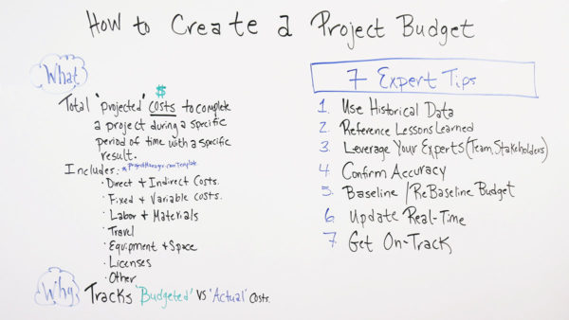
Unit III – Project Appraisal
Budgeting of Project
A project budget is the total projected costs needed to complete a project over a defined period of time. It’s used to estimate what the costs of the project will be for every phase of the project.
PROJECT MANAGEMENT
Notes:
A project is a unique endeavor to produce a set of deliverables within clearly specified time, cost and quality constraints. Projects are different from standard business operational activities as they:
• Are unique in nature. They do not involve repetitive processes. Every project undertaken is different from the last, whereas operational activities often involve undertaking repetitive (identical) processes.
• Have a defined timescale. Projects have a clearly specified start and end date within which the deliverables must be produced to meet a specified customer requirement.
• Have an approved budget. Projects are allocated a level of financial expenditure within which the deliverables are produced, to meet a specified customer requirement.
• Have limited resources. At the start of a project an agreed amount of labor, equipment and materials is allocated to the project.
• Involve an element of risk. Projects entail a level of uncertainty and therefore carry business risk.
• Achieve beneficial change. The purpose of a project is typically to improve an organization through the implementation of business change.

Slide 38
Unit III – Project Appraisal
Budgeting of Project
Top-down budgeting is a budgeting method in which senior management develops a high-level budget for the company. Once the top-level numbers are created, amounts are allocated to individual functions or departments that must create a detailed budget with their allocation.
Bottom up budgeting is a type of budgeting that attempts to determine the underlying costs for each individual department or segment of an organization and then total up each department.
PROJECT MANAGEMENT
Notes:
A project is a unique endeavor to produce a set of deliverables within clearly specified time, cost and quality constraints. Projects are different from standard business operational activities as they:
• Are unique in nature. They do not involve repetitive processes. Every project undertaken is different from the last, whereas operational activities often involve undertaking repetitive (identical) processes.
• Have a defined timescale. Projects have a clearly specified start and end date within which the deliverables must be produced to meet a specified customer requirement.
• Have an approved budget. Projects are allocated a level of financial expenditure within which the deliverables are produced, to meet a specified customer requirement.
• Have limited resources. At the start of a project an agreed amount of labor, equipment and materials is allocated to the project.
• Involve an element of risk. Projects entail a level of uncertainty and therefore carry business risk.
• Achieve beneficial change. The purpose of a project is typically to improve an organization through the implementation of business change.

Slide 39
Why You Need a Project Budget
The obvious answer is that projects cost money, but it’s more nuanced than that. The project budget is the engine that drives your project’s funding. It communicates to stakeholders how much money is needed and when it’s needed. Project budgets are important for any industry such as construction, marketing or manufacturing, for example.
But a project budget is not only a means to get things that your project requires. Yes, you need to pay teams, buy or rent equipment and materials, but that’s only half the story.
The other part of the importance of a project budget is that it’s an instrument to control project costs. The budget, which is part of your project plan, acts as a baseline to measure your performance as you collect the actual costs once the project has been started.

Slide 40
Project Budget Example
To further illustrate how a project budget is created, let’s pretend we’re making an app. The first thing you’ll need to figure out is the costs of labor and materials. You’ll need programmers, designers, content developers, a dev team, etc. It helps list all the tasks and assign the team to them—a hallmark of good task management. This way every penny is accounted for.
With the tasks broken down for the project and your team in place, you’ll next need to look into whatever materials will be needed. Will they need laptops, other devices and equipment? This must be accounted for.
Now note other line items. There might be travel expenses and renting space to house the team. Then there are fixed items that are true for any project. These are things where the cost is set and won’t change over the course of the project. You’ll also want a column for any miscellaneous costs that don’t fit elsewhere in the budget.
Your budget must have a planned versus actual column. When you’re making that app you’ve likely to pivot and that is going to impact the budget. These columns are a way to track the expenditure to ensure you’re staying on budget.

Slide 41
Unit III – Project Appraisal
Project Financing
PROJECT MANAGEMENT
Notes:
A project is a unique endeavor to produce a set of deliverables within clearly specified time, cost and quality constraints. Projects are different from standard business operational activities as they:
• Are unique in nature. They do not involve repetitive processes. Every project undertaken is different from the last, whereas operational activities often involve undertaking repetitive (identical) processes.
• Have a defined timescale. Projects have a clearly specified start and end date within which the deliverables must be produced to meet a specified customer requirement.
• Have an approved budget. Projects are allocated a level of financial expenditure within which the deliverables are produced, to meet a specified customer requirement.
• Have limited resources. At the start of a project an agreed amount of labor, equipment and materials is allocated to the project.
• Involve an element of risk. Projects entail a level of uncertainty and therefore carry business risk.
• Achieve beneficial change. The purpose of a project is typically to improve an organization through the implementation of business change.

Slide 42
Unit III – Project Appraisal
Project Financing
Project financing is a loan structure that relies primarily on the project's cash flow for repayment, with the project's assets, rights, and interests held as secondary collateral. Project finance is especially attractive to the private sector because companies can fund major projects off-balance sheet.
Sources of finance:
Project finance may come from a variety of sources. The main sources include equity, debt and government grants. Financing from these alternative sources have important implications on project's overall cost, cash flow, ultimate liability and claims to project incomes and assets.
PROJECT MANAGEMENT
Notes:
A project is a unique endeavor to produce a set of deliverables within clearly specified time, cost and quality constraints. Projects are different from standard business operational activities as they:
• Are unique in nature. They do not involve repetitive processes. Every project undertaken is different from the last, whereas operational activities often involve undertaking repetitive (identical) processes.
• Have a defined timescale. Projects have a clearly specified start and end date within which the deliverables must be produced to meet a specified customer requirement.
• Have an approved budget. Projects are allocated a level of financial expenditure within which the deliverables are produced, to meet a specified customer requirement.
• Have limited resources. At the start of a project an agreed amount of labor, equipment and materials is allocated to the project.
• Involve an element of risk. Projects entail a level of uncertainty and therefore carry business risk.
• Achieve beneficial change. The purpose of a project is typically to improve an organization through the implementation of business change.

Slide 43
UNIT- IV– Risk Analysis
Project Cost Estimation
Project Cost Estimation is defined as the process of approximating the total expenditure of the project. The accuracy of the cost estimation and budgeting in project management depends on the accuracy and details of the project scope, which is the scope baseline. The scope will also define any constraints like date, resources or budget. The risk register will help to calculate estimate types of costs, the expenses made behind the contingent action and the expenses made to cope with risks.
PROJECT MANAGEMENT
Notes:
A project is a unique endeavor to produce a set of deliverables within clearly specified time, cost and quality constraints. Projects are different from standard business operational activities as they:
• Are unique in nature. They do not involve repetitive processes. Every project undertaken is different from the last, whereas operational activities often involve undertaking repetitive (identical) processes.
• Have a defined timescale. Projects have a clearly specified start and end date within which the deliverables must be produced to meet a specified customer requirement.
• Have an approved budget. Projects are allocated a level of financial expenditure within which the deliverables are produced, to meet a specified customer requirement.
• Have limited resources. At the start of a project an agreed amount of labor, equipment and materials is allocated to the project.
• Involve an element of risk. Projects entail a level of uncertainty and therefore carry business risk.
• Achieve beneficial change. The purpose of a project is typically to improve an organization through the implementation of business change.

Slide 44
UNIT- IV– Risk Analysis
Project Cost Estimation
To estimate the cost of project you have to categorize various cost types into categories like
Labor cost
Equipment cost
Cost of supplies
Travel cost
Training cost
Overhead cost, etc.
PROJECT MANAGEMENT
Notes:
A project is a unique endeavor to produce a set of deliverables within clearly specified time, cost and quality constraints. Projects are different from standard business operational activities as they:
• Are unique in nature. They do not involve repetitive processes. Every project undertaken is different from the last, whereas operational activities often involve undertaking repetitive (identical) processes.
• Have a defined timescale. Projects have a clearly specified start and end date within which the deliverables must be produced to meet a specified customer requirement.
• Have an approved budget. Projects are allocated a level of financial expenditure within which the deliverables are produced, to meet a specified customer requirement.
• Have limited resources. At the start of a project an agreed amount of labor, equipment and materials is allocated to the project.
• Involve an element of risk. Projects entail a level of uncertainty and therefore carry business risk.
• Achieve beneficial change. The purpose of a project is typically to improve an organization through the implementation of business change.

Slide 45
UNIT- IV– Risk Analysis
Technique used to Estimate Cost
There are some techniques used to estimate a project cost like: Expert Judgement, Three-Point Estimation, Reserve Analysis and Cost of Quality.
However, to estimate project cost, formally there are few main methods (techniques) used as follows:
Analogous Estimating
Parametric estimating
Bottom-up estimating
PROJECT MANAGEMENT
Notes:
A project is a unique endeavor to produce a set of deliverables within clearly specified time, cost and quality constraints. Projects are different from standard business operational activities as they:
• Are unique in nature. They do not involve repetitive processes. Every project undertaken is different from the last, whereas operational activities often involve undertaking repetitive (identical) processes.
• Have a defined timescale. Projects have a clearly specified start and end date within which the deliverables must be produced to meet a specified customer requirement.
• Have an approved budget. Projects are allocated a level of financial expenditure within which the deliverables are produced, to meet a specified customer requirement.
• Have limited resources. At the start of a project an agreed amount of labor, equipment and materials is allocated to the project.
• Involve an element of risk. Projects entail a level of uncertainty and therefore carry business risk.
• Achieve beneficial change. The purpose of a project is typically to improve an organization through the implementation of business change.

Slide 46
UNIT- IV– Risk Analysis
Technique used to Estimate Cost
Analogous Estimating
This estimating technique is based on expert judgments and information based on similar previous projects. Where previously done similar project cost is considered with plus or minus of 20% for existing project.
2. Parametric estimating
Past data or record is used to estimate cost for the current project.
3. Bottom-up estimating
Once you have defined the scope of the project, it is the most reliable form of technique. In this technique, based on scope of the project, you estimate the cost for each resource or deliverables.
Likewise, there are other methods (techniques) which could be useful for estimating cost like PERT estimating, vendor bid analysis, etc.
PROJECT MANAGEMENT
Notes:
A project is a unique endeavor to produce a set of deliverables within clearly specified time, cost and quality constraints. Projects are different from standard business operational activities as they:
• Are unique in nature. They do not involve repetitive processes. Every project undertaken is different from the last, whereas operational activities often involve undertaking repetitive (identical) processes.
• Have a defined timescale. Projects have a clearly specified start and end date within which the deliverables must be produced to meet a specified customer requirement.
• Have an approved budget. Projects are allocated a level of financial expenditure within which the deliverables are produced, to meet a specified customer requirement.
• Have limited resources. At the start of a project an agreed amount of labor, equipment and materials is allocated to the project.
• Involve an element of risk. Projects entail a level of uncertainty and therefore carry business risk.
• Achieve beneficial change. The purpose of a project is typically to improve an organization through the implementation of business change.

Slide 47
UNIT- IV– Risk Analysis
Working Capital Requirement
The Working Capital Requirement (WCR) is a financial metric showing the amount of financial resources needed to cover the costs of the production cycle, upcoming operational expenses and the repayments of debts. In other words, it shows you the amount of money needed to finance the gap between payments to suppliers and payments from customers.
Logically, the working capital requirement calculation can be done via the following formula: WCR = Inventory + Accounts Receivable – Accounts Payable.
PROJECT MANAGEMENT
Notes:
A project is a unique endeavor to produce a set of deliverables within clearly specified time, cost and quality constraints. Projects are different from standard business operational activities as they:
• Are unique in nature. They do not involve repetitive processes. Every project undertaken is different from the last, whereas operational activities often involve undertaking repetitive (identical) processes.
• Have a defined timescale. Projects have a clearly specified start and end date within which the deliverables must be produced to meet a specified customer requirement.
• Have an approved budget. Projects are allocated a level of financial expenditure within which the deliverables are produced, to meet a specified customer requirement.
• Have limited resources. At the start of a project an agreed amount of labor, equipment and materials is allocated to the project.
• Involve an element of risk. Projects entail a level of uncertainty and therefore carry business risk.
• Achieve beneficial change. The purpose of a project is typically to improve an organization through the implementation of business change.

Slide 48
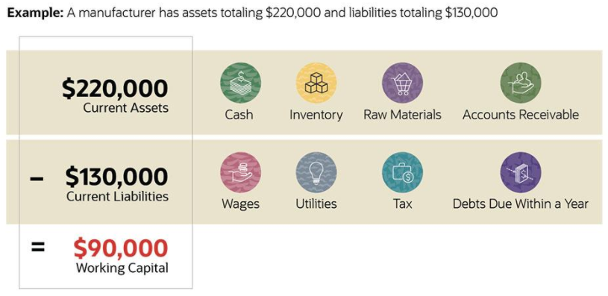
UNIT- IV– Risk Analysis
Working Capital Requirement
PROJECT MANAGEMENT
Notes:
A project is a unique endeavor to produce a set of deliverables within clearly specified time, cost and quality constraints. Projects are different from standard business operational activities as they:
• Are unique in nature. They do not involve repetitive processes. Every project undertaken is different from the last, whereas operational activities often involve undertaking repetitive (identical) processes.
• Have a defined timescale. Projects have a clearly specified start and end date within which the deliverables must be produced to meet a specified customer requirement.
• Have an approved budget. Projects are allocated a level of financial expenditure within which the deliverables are produced, to meet a specified customer requirement.
• Have limited resources. At the start of a project an agreed amount of labor, equipment and materials is allocated to the project.
• Involve an element of risk. Projects entail a level of uncertainty and therefore carry business risk.
• Achieve beneficial change. The purpose of a project is typically to improve an organization through the implementation of business change.

Slide 49
UNIT- IV– Risk Analysis
Prepare Projected Balance Sheet
Following steps will be helpful for preparing projected balance sheet.
Calculate cash in hand and cash at bank
Calculate Fixed Assets
Calculate Value of Financial Instruments
Calculate your Business Earning
Calculate Business's Liabilities
Calculate Business's Capital
PROJECT MANAGEMENT
Notes:
A project is a unique endeavor to produce a set of deliverables within clearly specified time, cost and quality constraints. Projects are different from standard business operational activities as they:
• Are unique in nature. They do not involve repetitive processes. Every project undertaken is different from the last, whereas operational activities often involve undertaking repetitive (identical) processes.
• Have a defined timescale. Projects have a clearly specified start and end date within which the deliverables must be produced to meet a specified customer requirement.
• Have an approved budget. Projects are allocated a level of financial expenditure within which the deliverables are produced, to meet a specified customer requirement.
• Have limited resources. At the start of a project an agreed amount of labor, equipment and materials is allocated to the project.
• Involve an element of risk. Projects entail a level of uncertainty and therefore carry business risk.
• Achieve beneficial change. The purpose of a project is typically to improve an organization through the implementation of business change.

Slide 50
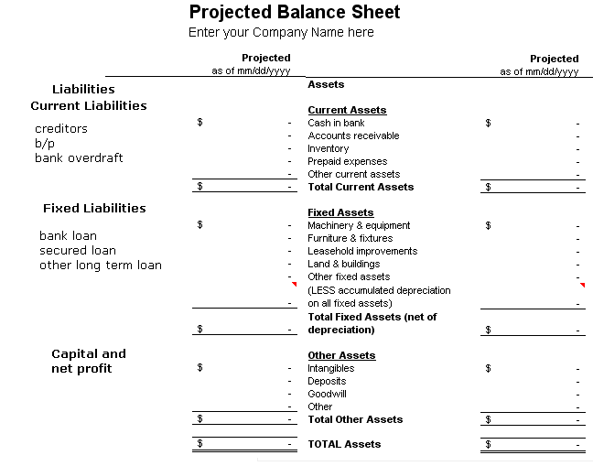
UNIT- IV– Risk Analysis
Prepare Projected balance Sheet
PROJECT MANAGEMENT
Notes:
A project is a unique endeavor to produce a set of deliverables within clearly specified time, cost and quality constraints. Projects are different from standard business operational activities as they:
• Are unique in nature. They do not involve repetitive processes. Every project undertaken is different from the last, whereas operational activities often involve undertaking repetitive (identical) processes.
• Have a defined timescale. Projects have a clearly specified start and end date within which the deliverables must be produced to meet a specified customer requirement.
• Have an approved budget. Projects are allocated a level of financial expenditure within which the deliverables are produced, to meet a specified customer requirement.
• Have limited resources. At the start of a project an agreed amount of labor, equipment and materials is allocated to the project.
• Involve an element of risk. Projects entail a level of uncertainty and therefore carry business risk.
• Achieve beneficial change. The purpose of a project is typically to improve an organization through the implementation of business change.

Slide 51
UNIT- IV– Risk Analysis
Prepare Income Statement
The income statement is found as follows:
Sales revenue
Less cost of goods sold
Gross profit
Less SG&A
EBITDA
Less Depreciation Expense
EBIT or Operating Income
Less Interest Expense
EBT
Less Tax Expense
Net Income
PROJECT MANAGEMENT
Notes:
A project is a unique endeavor to produce a set of deliverables within clearly specified time, cost and quality constraints. Projects are different from standard business operational activities as they:
• Are unique in nature. They do not involve repetitive processes. Every project undertaken is different from the last, whereas operational activities often involve undertaking repetitive (identical) processes.
• Have a defined timescale. Projects have a clearly specified start and end date within which the deliverables must be produced to meet a specified customer requirement.
• Have an approved budget. Projects are allocated a level of financial expenditure within which the deliverables are produced, to meet a specified customer requirement.
• Have limited resources. At the start of a project an agreed amount of labor, equipment and materials is allocated to the project.
• Involve an element of risk. Projects entail a level of uncertainty and therefore carry business risk.
• Achieve beneficial change. The purpose of a project is typically to improve an organization through the implementation of business change.

Slide 52
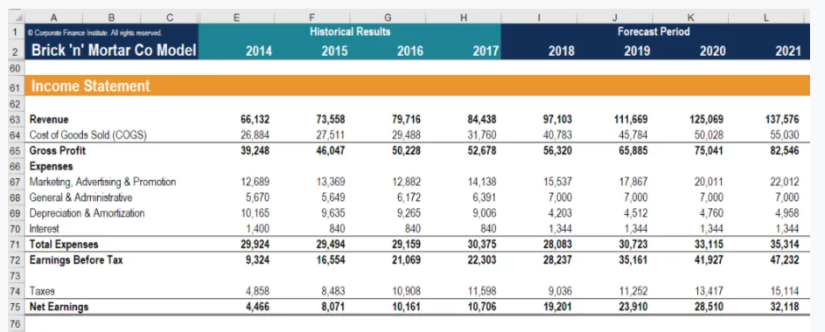
UNIT- IV– Risk Analysis
Prepare Income Statement
PROJECT MANAGEMENT
Notes:
A project is a unique endeavor to produce a set of deliverables within clearly specified time, cost and quality constraints. Projects are different from standard business operational activities as they:
• Are unique in nature. They do not involve repetitive processes. Every project undertaken is different from the last, whereas operational activities often involve undertaking repetitive (identical) processes.
• Have a defined timescale. Projects have a clearly specified start and end date within which the deliverables must be produced to meet a specified customer requirement.
• Have an approved budget. Projects are allocated a level of financial expenditure within which the deliverables are produced, to meet a specified customer requirement.
• Have limited resources. At the start of a project an agreed amount of labor, equipment and materials is allocated to the project.
• Involve an element of risk. Projects entail a level of uncertainty and therefore carry business risk.
• Achieve beneficial change. The purpose of a project is typically to improve an organization through the implementation of business change.

Slide 53
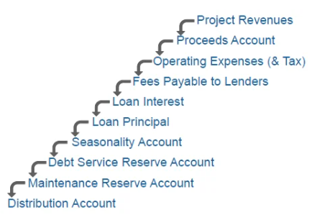
UNIT- IV– Risk Analysis
Cash Flow Statement
The cashflow waterfall is negotiated between the borrower (the SPV) and the lender and is stated in the loan agreement. Below is a hypothetical cashflow waterfall which you might see in the market. They vary, but here is one!
PROJECT MANAGEMENT
Notes:
A project is a unique endeavor to produce a set of deliverables within clearly specified time, cost and quality constraints. Projects are different from standard business operational activities as they:
• Are unique in nature. They do not involve repetitive processes. Every project undertaken is different from the last, whereas operational activities often involve undertaking repetitive (identical) processes.
• Have a defined timescale. Projects have a clearly specified start and end date within which the deliverables must be produced to meet a specified customer requirement.
• Have an approved budget. Projects are allocated a level of financial expenditure within which the deliverables are produced, to meet a specified customer requirement.
• Have limited resources. At the start of a project an agreed amount of labor, equipment and materials is allocated to the project.
• Involve an element of risk. Projects entail a level of uncertainty and therefore carry business risk.
• Achieve beneficial change. The purpose of a project is typically to improve an organization through the implementation of business change.

Slide 54
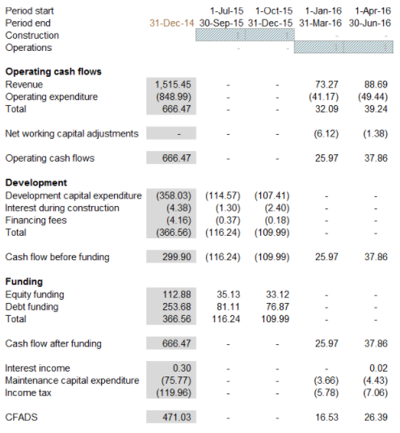
UNIT- IV– Risk Analysis
Cash Flow Statement
PROJECT MANAGEMENT
Notes:
A project is a unique endeavor to produce a set of deliverables within clearly specified time, cost and quality constraints. Projects are different from standard business operational activities as they:
• Are unique in nature. They do not involve repetitive processes. Every project undertaken is different from the last, whereas operational activities often involve undertaking repetitive (identical) processes.
• Have a defined timescale. Projects have a clearly specified start and end date within which the deliverables must be produced to meet a specified customer requirement.
• Have an approved budget. Projects are allocated a level of financial expenditure within which the deliverables are produced, to meet a specified customer requirement.
• Have limited resources. At the start of a project an agreed amount of labor, equipment and materials is allocated to the project.
• Involve an element of risk. Projects entail a level of uncertainty and therefore carry business risk.
• Achieve beneficial change. The purpose of a project is typically to improve an organization through the implementation of business change.

Slide 55
Unit II – Project Formulation
Project Identification
PROJECT MANAGEMENT
Notes:
A project is a unique endeavor to produce a set of deliverables within clearly specified time, cost and quality constraints. Projects are different from standard business operational activities as they:
• Are unique in nature. They do not involve repetitive processes. Every project undertaken is different from the last, whereas operational activities often involve undertaking repetitive (identical) processes.
• Have a defined timescale. Projects have a clearly specified start and end date within which the deliverables must be produced to meet a specified customer requirement.
• Have an approved budget. Projects are allocated a level of financial expenditure within which the deliverables are produced, to meet a specified customer requirement.
• Have limited resources. At the start of a project an agreed amount of labor, equipment and materials is allocated to the project.
• Involve an element of risk. Projects entail a level of uncertainty and therefore carry business risk.
• Achieve beneficial change. The purpose of a project is typically to improve an organization through the implementation of business change.

Slide 56
Unit II – Project Formulation
Project Identification
Collection, compilation and analysis of data to locate potential opportunities for starting business and development of such opportunities
Opportunity is a business concept, which if turned into a tangible product or service, by the enterprise, will result into profit. It is all about creating values
The search of a good idea:
Generate your own idea
Develop someone else’s idea
PROJECT MANAGEMENT

Slide 57
Unit II – Project Formulation
Importance of Project Identification
It has long term consequences (make or break)
Involves commitment which can not be easily reversed
Ideas are put into action
Projects are catalytic agents for economic development
Involves creative use of resources- manpower, capital, raw materials etc.
Generates value addition and build-up national capital
Brings socio-cultural development
Leads to development of infra-structure and environment
PROJECT MANAGEMENT

Slide 58
Unit II – Project Formulation
Steps in Project Identification
Idea Generation
Preliminary Screening
Project feasibility
Support study
Detailed Project Report
PROJECT MANAGEMENT
Notes:
A project is a unique endeavor to produce a set of deliverables within clearly specified time, cost and quality constraints. Projects are different from standard business operational activities as they:
• Are unique in nature. They do not involve repetitive processes. Every project undertaken is different from the last, whereas operational activities often involve undertaking repetitive (identical) processes.
• Have a defined timescale. Projects have a clearly specified start and end date within which the deliverables must be produced to meet a specified customer requirement.
• Have an approved budget. Projects are allocated a level of financial expenditure within which the deliverables are produced, to meet a specified customer requirement.
• Have limited resources. At the start of a project an agreed amount of labor, equipment and materials is allocated to the project.
• Involve an element of risk. Projects entail a level of uncertainty and therefore carry business risk.
• Achieve beneficial change. The purpose of a project is typically to improve an organization through the implementation of business change.

Slide 59

Unit II – Project Formulation
Project Identification
Idea Generation or Investment Opportunities
Idea generation is the process of grouping logical thoughts based on some factors.
Importance:
Launch of new business / product
Continuous growth of Organization
Survival in the competitive Market
Development of Society
PROJECT MANAGEMENT

Slide 60

Unit II – Project Formulation
Project Identification
Source of Idea Generation
Performance of existing Industry
Examining the inputs and Outputs of various Industry
Review Trade (Local and International)
Availability of Material and Labour at Low cost
Price Trend
Demand and supply Gap
Government guidelines (legal issues)
Economic and social Trends
Study of New Technology and Developments
PROJECT MANAGEMENT

Slide 61



Unit II – Project Formulation
Project Identification
Pre-Feasibility Study / Preliminary Screening
A series of steps to know whether or not a complete detailed feasibility study should be made.
Preliminary screening is done with a view to avoid unnecessary cost and efforts in detailed study.
Collection of data without spending much money and time:
Interview with Government Officials
Interview with Beneficiaries (customers)
Libraries and other sources of data collection
PROJECT MANAGEMENT

Slide 62

Unit II – Project Formulation
Project Identification
Error in Pre-Feasibility Study
Drop Error:
When a good idea is rejected (Loss of Profit)
Go Error:
When a bad idea is selected (heavy loss)
PROJECT MANAGEMENT

Slide 63
Unit II – Project Formulation
Preliminary Screening Project rating Index Method
PROJECT SCORE SHEET (UNWEIGHTED)
SECTION I - BASIS OF PROJECT DECISION
 | Definition Level (Rating) |  |  |  |  |  |  | Weight | Factor Score
CATEGORY Element | 0 | 1 | 2 | 3 | 4 | 5 | Score | (out of 1) | Weight X Rating
A. BUSINESS STRATEGY
A1. Building Use
A2. Business Justification
A3. Business Plan
A4. Economic Analysis
A5. Facility Requirements
A6. Future Expansion/Alteration Considerations
A7. Site Selection Considerations
A8. Project Objectives Statement
B. OWNER PHILOSOPHIES
B1. Reliability Philosophy
B2. Maintenance Philosophy
B3. Operating Philosophy
B4. Design Philosophy
C. PROJECT REQUIREMENTS
C1. Value-Analysis Process
C2. Project Design Criteria
C3. Evaluation of Existing Facilities
C4. Scope of Work Overview
C5. Project Schedule
C6. Project Cost Estimate
Definition Levels
0 = Not Applicable, 1 = Complete Definition, 2 = Minor Deficiencies, 3 = Some Deficiencies , 4 = Major Deficiencies, 5 = Incomplete or Poor Definition
PROJECT MANAGEMENT

Slide 64

Unit II – Project Formulation
Steps in Project rating Index Method
Identify relevant factors (Useful to the project).
Assign weight to each factor on the basis of importance.
Rate each factors on the rating scale
Multiply the factor rating with factor weight (get factor score)
Make a sum of weighted factor score (get rating index)
Reject if value is less than desired value
Accept if value is more than desired value
PROJECT MANAGEMENT

Slide 65

Unit II – Project Formulation
Feasibility Study / Detailed Feasibility study
To identify the selection or rejection of the project by spending money and time on the basis of primary data in formal way.
Objectives:
It guarantees the success of the project
It works as basic ‘Terms of reference’
Describes nature and complexity
Gives an idea about investment in project
Idea of risk involved
Idea about economic and social benefits
PROJECT MANAGEMENT

Slide 66
Unit II – Project Formulation
Components of Detailed Feasibility study
Market and Demand Analysis
Technical Analysis
Financial Analysis
Social cost-benefit Analysis
Environmental and other Risk analysis
PROJECT MANAGEMENT

Slide 67

Unit II – Project Formulation
Support Study / Functional Study
An in depth investigation into any one or a couple of critical aspects of a project, to help the feasibility study
It may be done:
Before Pre-feasibility Study
Before feasibility Study
After Pre-feasibility Study
After feasibility Study
Example: Launching of new cola in a market with a critical factor pricing.
A support study is required to study specifically price of other competitive products and cost of self
PROJECT MANAGEMENT

Slide 68
Unit II – Project Formulation
Pre- Feasibility Study Vs Feasibility study
Factors | Pre-Feasibility Study | Feasibility Study
Objective | Whether or not the project idea needs further investigation | To determine the true profitability
Scope | Overview study | Detailed Study
Type of Data | Secondary Data (informal sources) | Mix of Primary and Secondary data ( both formal and informal sources)
Time involved | Low | High
Cost involved | Low | High
Accuracy | Low | High
PROJECT MANAGEMENT

Slide 69
Unit II – Project Formulation
Detailed Project Report (DPR)
A formal written document containing the process of project formulation and briefing the project scope.
PROJECT MANAGEMENT

Slide 70
Unit II – Project Formulation
Detailed Project Report (DPR)
STEPS IN DPR PREPARATION:
Step (i): Selection of project
Step (ii): Resource possession and use
Step (iii) : Survey and Mapping
Step (iv) : Assessment of Deficiencies
Step (v) : Integration of Social Infrastructure
Step (vi) : Establishing Linkages with City-wide infrastructure Network
Step (vii) : Preparation of Detailed Designs after assessment of Demand / Gap
Step (viii) : Statutory approvals
Step (ix) : Estimation of Project Cost
Step (x) : Implementation and Management arrangements
Step (xi): Operation and Maintenance plan of proposed assets..
PROJECT MANAGEMENT

